Slide 1
Real-Time AI Sales Intelligence and Sentiment-Driven Deal Negotiation
Experience the future of sales

Slide 2
Agenda
INTRODUCTION
SPEECH ANALYSIS
TONE ANALYSIS
RECOMMENDATION ENGINE
FRONTEND OUTPUT
BACKEND OUTPUT
FINAL OUTPUT
CONCLUSION

Slide 3
Introduction
The Real-Time AI Sales Intelligence and Sentiment-Driven Deal Negotiation Assistant is an AI-powered tool that enhances sales calls with real-time sentiment analysis and dynamic deal recommendations.
Analyzes buyer sentiment to adjust negotiation strategies instantly.
Suggests personalized deal terms based on CRM data and buyer needs.
Provides detailed summaries and insights for future engagement.
Offers real-time recommendation for handling objections and improving negotiation .

Slide 4
Speech Analysis
LLMs like OpenAI GPT or Meta LLaMA analyze buyer sentiment (positive, negative, neutral) from text during calls.
NLU models like Gemini determine buyer intent (e.g., interested, hesitant), adjusting sales strategies in real time.
Text-to-speech libraries such as Google Text-to-Speech and Amazon Polly assess buyer tone, tailoring responses accordingly.
Speech emotion recognition tools like Deepgram or Microsoft Azure Speech API detect pitch shifts and emotional changes in voice.
Sentiment, intent, tone, and pitch data are combined to dynamically adjust negotiation strategies and improve sales outcomes.

Slide 5
TONE ANALYSIS
Sentiment and Tone Assessment:
Analyzes the overall sentiment and tone from the conversation to evaluate the effectiveness of the negotiation.
Deal Status Update: Tracks progress, updates deal stages, and adjusts next steps based on the call outcome.
Performance Insights: Provides feedback on the sales rep's performance, highlighting strengths and areas for improvement.
Actionable Recommendations: Suggests follow-up actions, including additional negotiation strategies or adjustments based on buyer behavior.
CRM Data Integration:
Updates CRM systems with key insights from the call to enhance future interactions and track deal progress.

Slide 6
RECOMMENDATION ENGINE
Collaborative Filtering:
Recommends deal terms based on similarities in buyer behavior and historical data.
Content-Based Filtering:
Suggests deals tailored to the buyer’s past preferences and CRM data.
Hybrid Methods:
Combines both collaborative and content-based filtering for personalized, accurate recommendations.
Context-Aware Systems:
Adapts recommendations based on real-time factors like sentiment, tone, and buyer engagement during the call.

Slide 7

FRONTEND OUTPUT

Slide 8
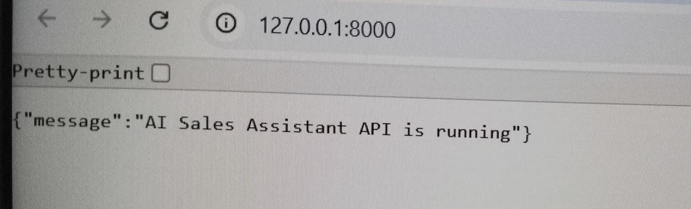
BACKEND OUTPUT

Slide 9

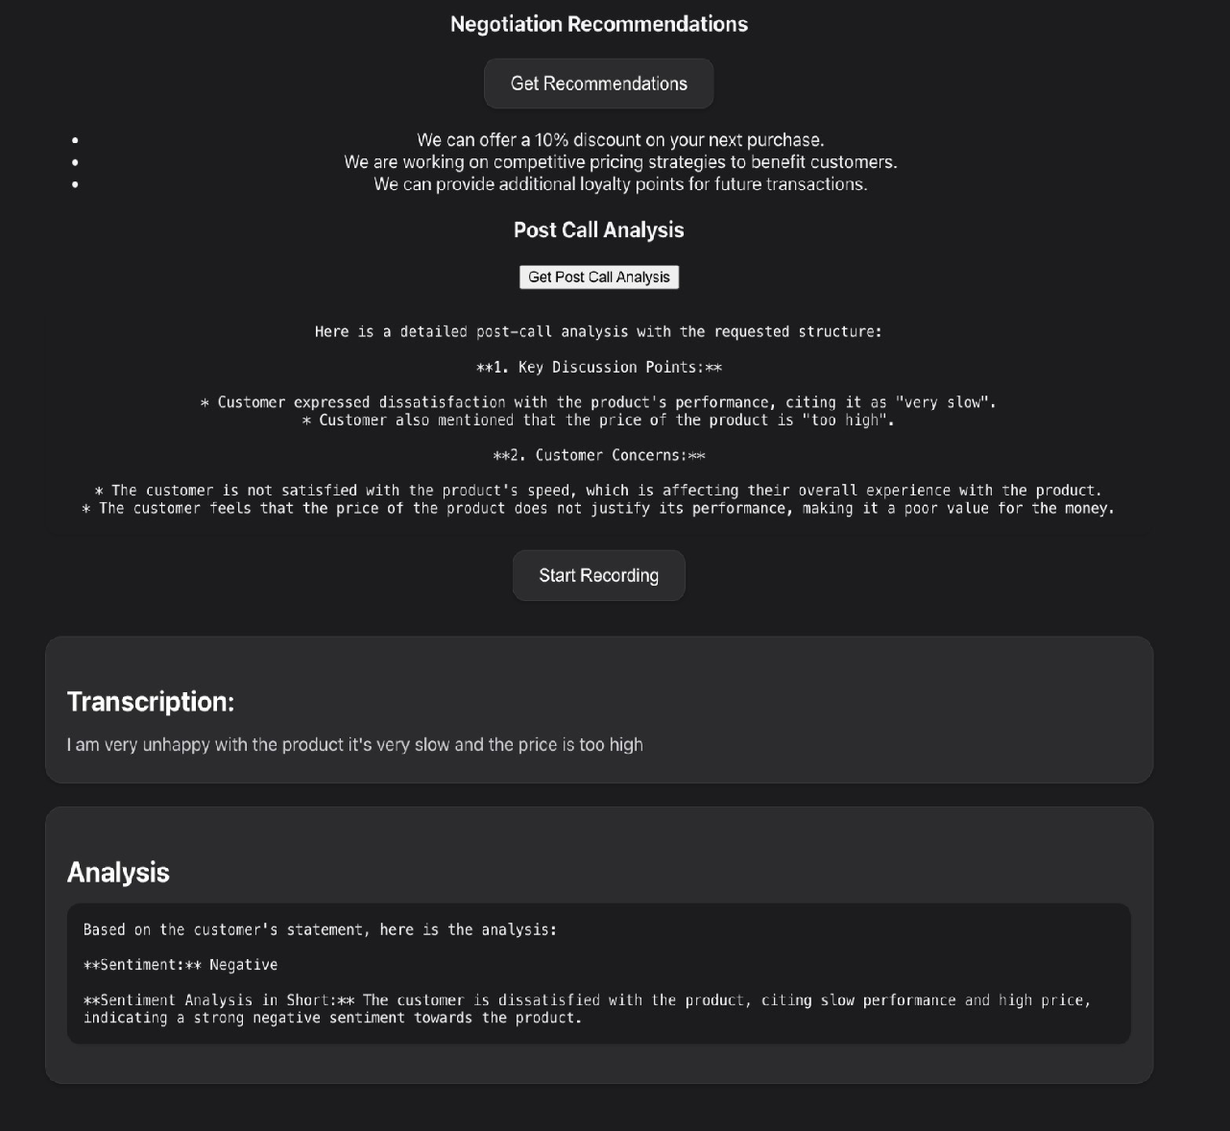
FINAL OUTPUT

Slide 10
CONCLUSION
In conclusion, the Real-Time AI Sales Intelligence and Sentiment-Driven Deal Negotiation Assistant transforms traditional sales methods by blending cutting-edge AI with human intuition.
By harnessing real-time sentiment insights, dynamic deal recommendations, and actionable post-call feedback, the system doesn’t just support sales reps, it empowers them to anticipate buyer needs, adapt strategies on the fly, and close deals more effectively. With every call, it learns and evolves, creating a continuously improving sales experience that drives smarter decisions, stronger relationships, and higher conversions.
This is the future of sales, intelligent, adaptive, and always one step ahead.

Slide 11
THANK YOU

